Slide 1
GTU CSE495 Smart Mobile Application for Identification and Tracking Packaging in Recycling
CSE495
First Presentation
Emre Güven
Project Advisor: Prof. Dr. Yusuf Sinan AKGÜL
November 2023

Slide 2
Contents
Motivation
Schema and Description of The Project
Project Design Plan
Project Requirements – Job Packages
Project Requirements – Tools & Needs
Project Timeline
Success Criteria
References

Slide 3
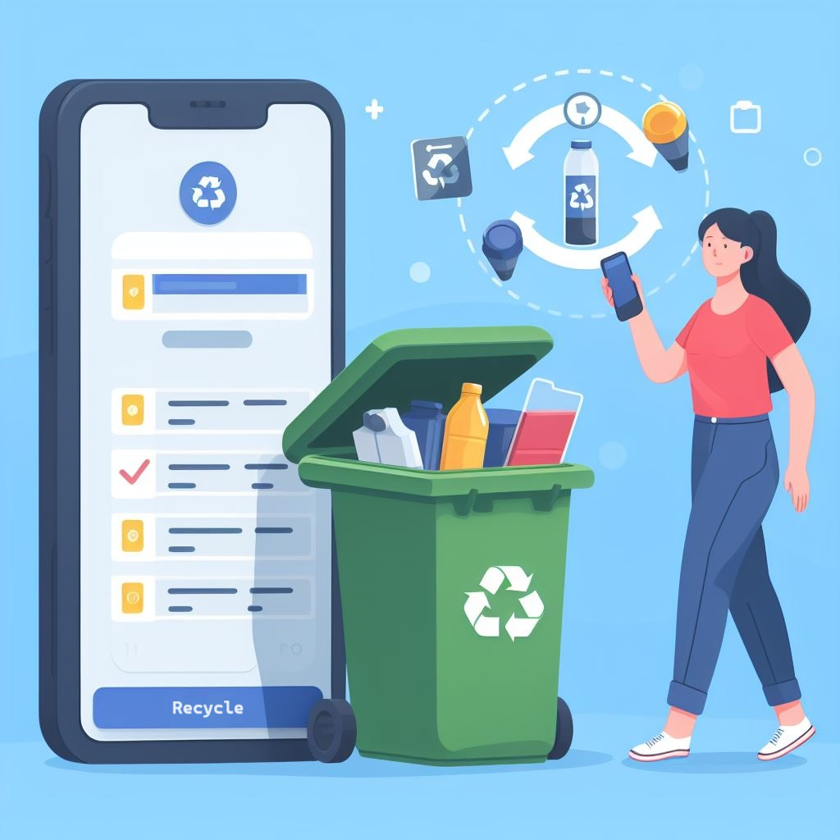
Motivation
Take a step towards a cleaner future by recycling
and stay informed about your eco-friendly contributions!

Slide 4
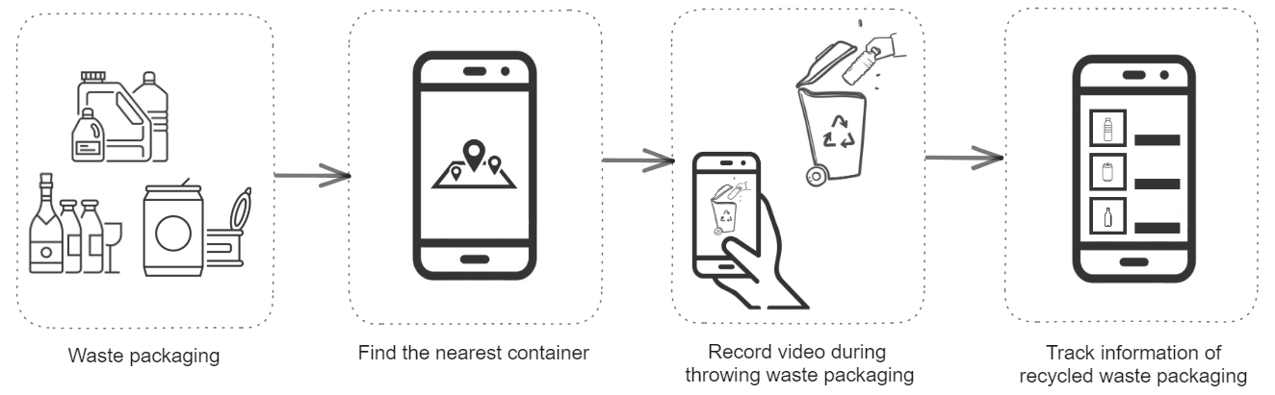
Schema and Description of The Project
A mobile application that can recognize the recyclable waste packaging materials and the action of throwing materials into the recycling container.
Users are able to track information about the waste packaging they have previously thrown into recycling containers.

Slide 5
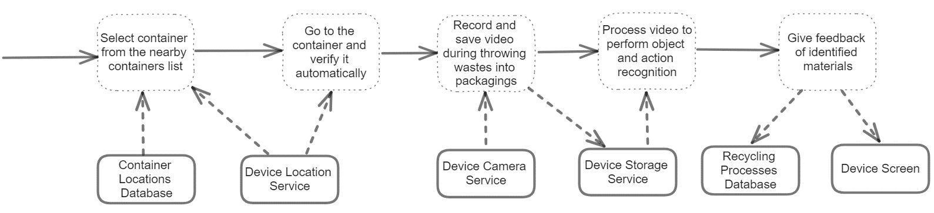
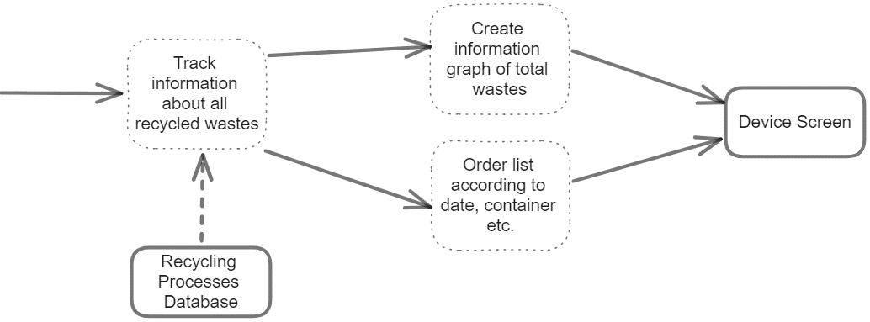
Project Design Plan
Recognition of waste packaging materials
Tracking information about pre-recycled wastes

Slide 6
Project Requirements – Job Packages
Designing and implementing interfaces for; finding and selecting the nearest container, verifying selected container, recording video, showing feedback and tracking the information of the previously thrown wastes.
Preparing location dataset of pre-determined containers.
Preparing a dataset of packaging materials (plastic, metal, glass) that can be thrown into containers.
Developing object detection algorithm to identify materials in the video.
Developing video classification algorithm to identify action of throwing packaging into containers.
Training algorithms with custom dataset.
Integrating models into mobile application.

Slide 7
Project Requirements – Tools & Needs
Android mobile phone, a device with at least Android 8.1 version and its camera, local storage, and location services.
Android Studio and Android SDK, provides environment, tools and APIs for application development.
Kotlin, programming language for mobile application development.
Room Database, SQLite based local database tool for Android.
Python, programming language used for ML algorithms in project.
Tensorflow Lite, an open-source framework for running machine learning models on mobile and edge devices.
OpenCV, a library that mainly provides tools for real-time computer vision.
Label Studio, a tool for data labeling.
Data, pre-recorded videos for ML models and container locations datas.

Slide 8
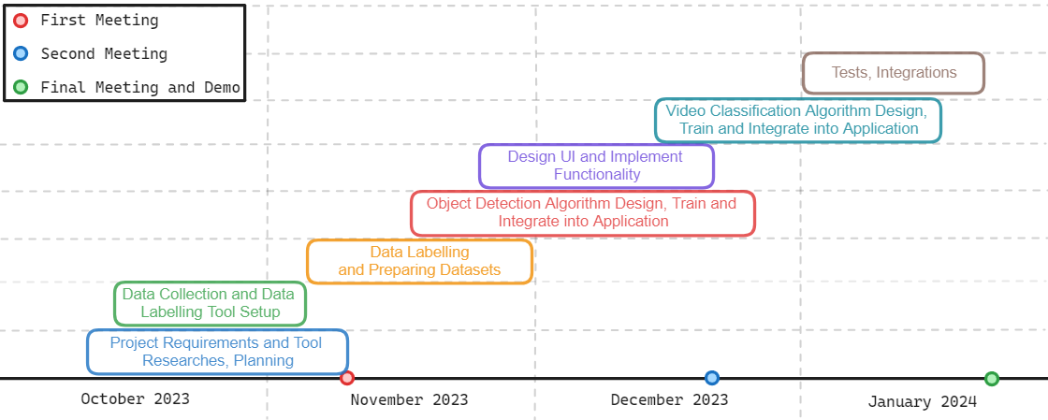
Project Timeline

Slide 9
Success Criteria
The type and the quantity of waste packaging materials should be detected with at least 80% accuracy.
Containers should be detected with at least 90% accuracy.
At least 5 frame per second should be received and processed. Result should be shown to the user at most 10 seconds.

Slide 10
References
Recycling Material Classification using Convolutional Neural Networks , 2022 21st IEEE International Conference on ML and Applications
MoViNets: Mobile Video Networks for Efficient Video Recognition, arXiv:2103.11511v2 [cs.CV] 18 Apr 2021
Smartphone‑based real‑time object recognition architecture for portable and constrained systems, Journal of Real-Time Image Processing (2022) 19:103–115
https://www.tensorflow.org/lite/android/tutorials/object_detection
https://www.tensorflow.org/hub/tutorials/movinet
https://www.tensorflow.org/lite/models/modify/model_maker/object_detection
https://www.biriktir.app/
https://labelstud.io/

